Slide 1
DEEP LEARNING BASED ON FOOD IMAGE RECOGNITION AND PORTION SIZE DETERMINATION
TEAM MEMBERS
Shreyaa Sridhar ( 21 )
Khushbu Kolhe ( 9 )
Naga Venkata Satya Pranoop Mutha ( 15 )
Geovanni Nicque West ( 23 )

Slide 2
Objective
To implement the Food Image Recognition and Portion Size Determination
system that recognizes the image and determines the calories and portion size.
The model will be trained on thousands of images to extract the important
features of these images.
Food-101 Dataset.
Reference link - https://www.vision.ee.ethz.ch/datasets_extra/food-101/
DataSet

Slide 3
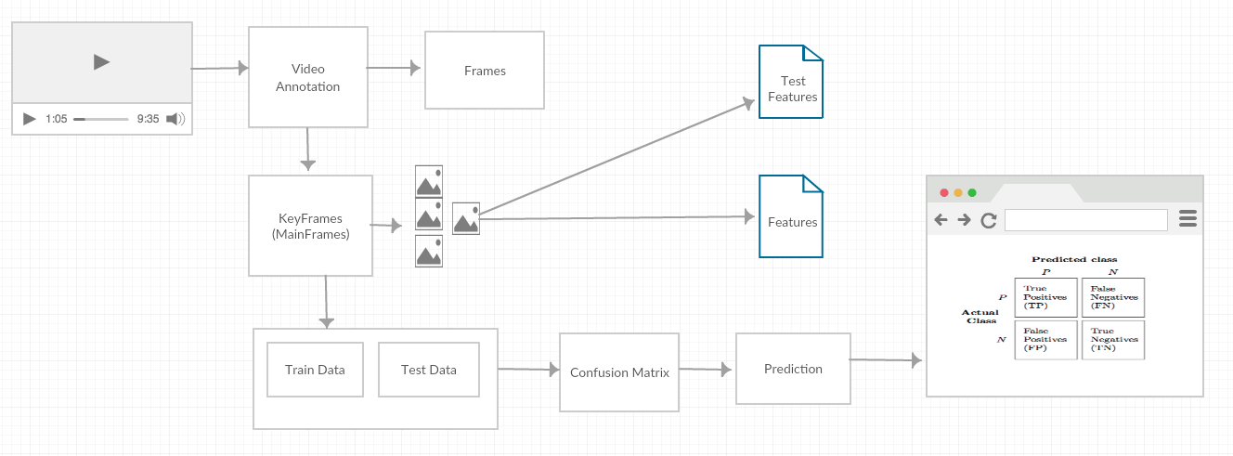
Architecture Diagram

Slide 4
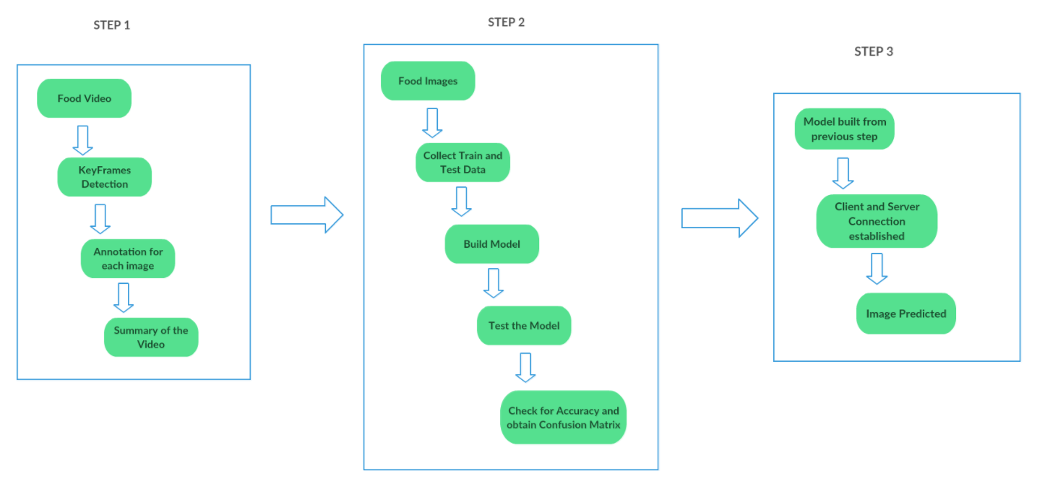
Increment 1
Input Used: Food.mkv file, which is a combination of pictures from Food - 101 dataset
Algorithms Used: K -Means, Decision Tree, Random Forest and Naive Bayes Models

Slide 5
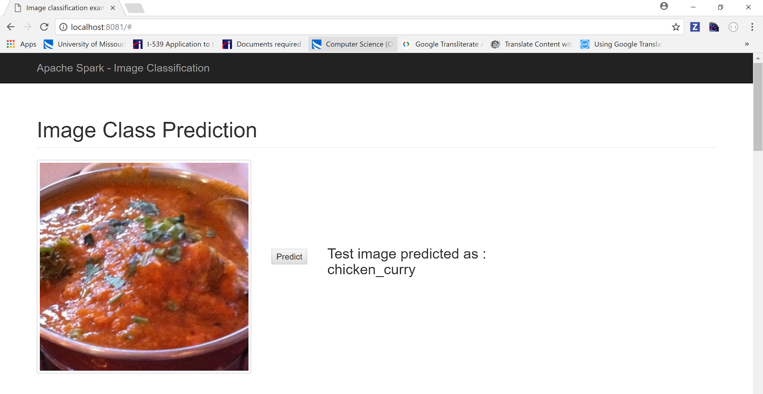
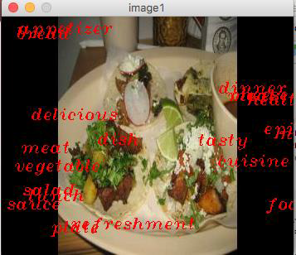
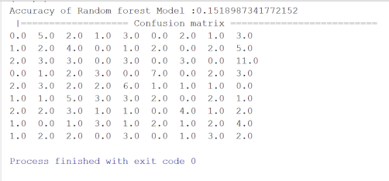
Outputs generated..
OBJECT DETECTION
IMAGE CLASSIFICATION
IMAGE PREDICTION

Slide 6
Challenges faced..
We had to use small dataset due to lack of proper hardware resource.
Faced accuracy issue because we trained our model with a small dataset.

Slide 7
Next Increment..
Data Enhancement to improve accuracy our model
Image Classification using deep learning models
Nutritional facts implementation
Develop a mobile application

Slide 8
THANK YOU

